Slide 1

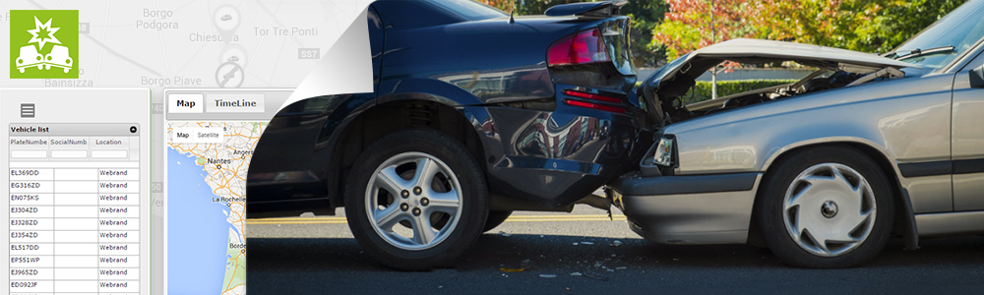
CLOUD ENABLED VEHCILE THEFT AND ACCIDENT DETECTION SYSTEM
SUBMITTED BY:
Group : TRIO
K.Naga Ramya Sree
S.Bhargavi
V.Mounika

Slide 2
INTRODUCTION:
In today’s scenario, owning multiple vehicles is considered a social status in the society and consequently the number of vehicles on the roads has increased immensely in the past decade. On one hand, this may be seen as an improvement in the standards of living of people, subsequently, it cannot be denied that there is a stark increase of road accidents, air pollution caused by the vehicles and crimes related to the vehicles like theft etc.[10]. The proposed work seeks to develop a system which facilitates accident notification to the appropriate agencies and in tracing the vehicle in case of theft and controlling the air pollution. There has not been much work in this area using cloud services. The proposed system applies cloud services in finding solution to the mentioned scenarios. The main objectives of the proposed project system are:1) To enable accident notification to appropriate agencies. 2) To provide a system for controlling the functionality of vehicle in case of theft. 3) To alert against pollution levels caused by the vehicle

Slide 3
PROJECT HIGHLIGHTS:
Integration of GPS module
Serial communication between Arduino and Node MCU
IBM Cloud integration between device and mobile application
Sending the required alerts in the form of notifications
Opening the door by giving the security code from mobile application

Slide 4
PRELIMINARIES:
HARDWARE:
ESP8266 12E module
Arduino UNO
GPS module
Servo motor
Push buttons
Buzzer
Accelerometer

Slide 5
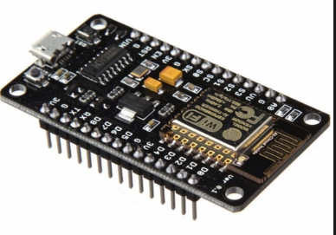
SOFTWARE:
Arduino IDE
IBM Cloud platform
MIT App studio
ESP8266 12E module:
ESP8266 can be controlled from your local WiFi network or from the internet (after port forwarding).the ESP-01 module has GPIO pins that can be programmed to turn on led through internet. The module can be programmed using an Arduino USB-to-TTL converter through the serial pins(RX,TX).

Slide 6
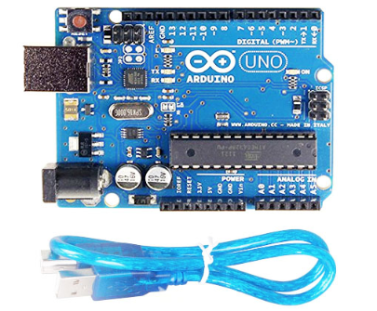
.
ARDUINO UNO:
Arduino UNO is an open source microcontroller board based on the
Board based on the microchip ATmega328p microcontroller and
Developed by www.arduino.cc. The board is equipped with sets of digital
and Analog input-output pins that may be interfaced to various
expansion boards and other circuits. Arduino can be stand-alone
Or they can communicate with software on running on computer.

Slide 7
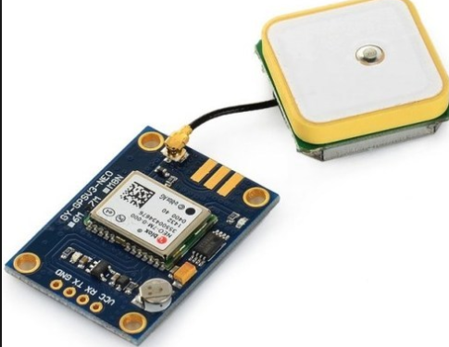
.
GPS MODULE:
The working of global positioning system is based on the ‘trilateration’ mathematical principle .the position is determined. The position is determined From the distance measurements to satellites.4 satellites are used to determine the position of the receiver on the earth. The target location is confirmed by 4 satellite. And three satellites are used to trace the location place , a 4th satellite is used to confirm the target location of each of those space vehciles.GPS consists of satellite, control station and monitor station and receiver. The GPS receiver takes the information from the satellite and uses the method of triangulation to determine a users exact position.

Slide 8
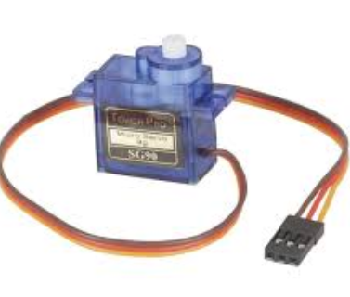
SERVO MOTOR:
Servo motors control position and speed very precisely. Now a potentiometer can sense the mechanical position of the shaft. Hence it couples with the motor shaft through gears. The current position of the shaft is converted into electrical signal by potentiometer, and is compared with the command input signal. We amplify this error signal and apply as the input to the motor hence the motor rotates. And when the shaft reaches to the require position, error signal become zero, and the command input is in form of electrical pulses. As the actual input to the motor is the difference between feedback signal (current position) and required signal, hence speed of the motor is proportional to the difference between the current position and required position. The amount of power require by the motor is proportional to the distance it needs to travel.2

Slide 9
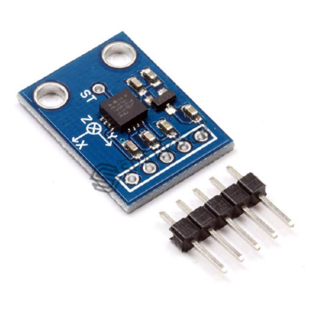
.
ACCELEROMETER:
Which consists of a small mass which is etched into silicon surface and then integrated into a small circuit. When force is applied on this mass then it covers some displacement, so acceleration is produced in this mass according to newton second law of motion F= ma which is sensed by its sensor. Similarly, if we talk about Analog accelerometers then they work on two principles such as capacitive sensing and piezo electric sensing. Both have different advantages and disadvantages. Similarly, ADXL335 accelerometer is an Analog accelerometer therefore it works on the principle of capacitive sensing. In capacitive sensing accelerometer, when it is moved in any direction then its capacitance is changed. When this capacitance is changed then its Analog voltages are changed which is sensed by its interfacing controller

Slide 10
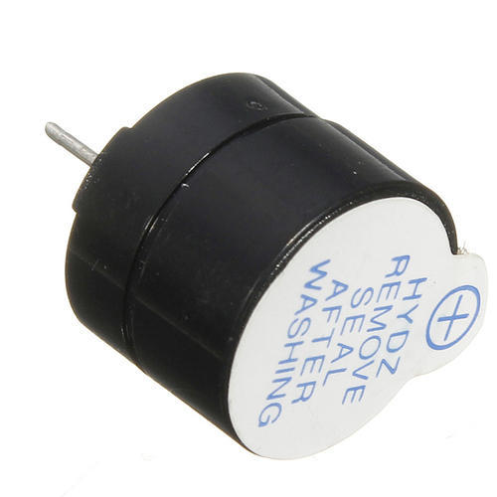
‘
BUZZER:
A buzzer is a small yet efficient component to add sound features to our project/system. It is very small and compact 2-pin structure hence can be easily used on breadboard.
The simple buzzer which when powered will make a Continuous Beep.... sound, the other is called a readymade buzzer which will look bulkier than this and will produce a Beep. Beep. Beep. Sound due to the internal oscillating circuit present inside it. But the one shown here is most widely used because it can be customised with help of other circuits to fit easily in our application.

Slide 11
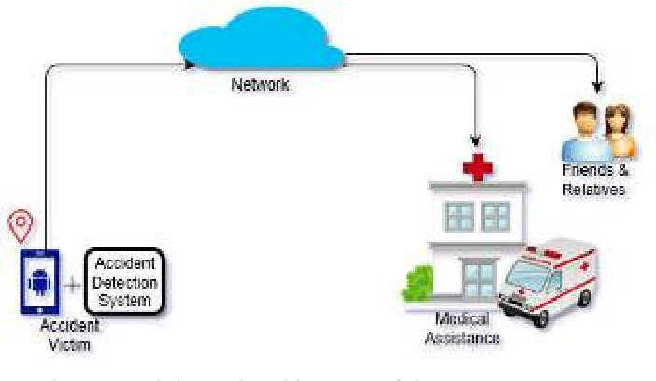
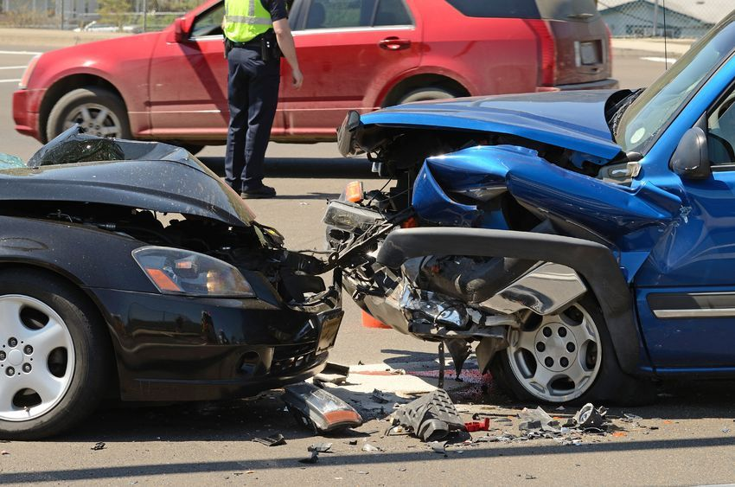
WORKING PROCESS FOR ACCIDENT DETECTION:

Slide 12
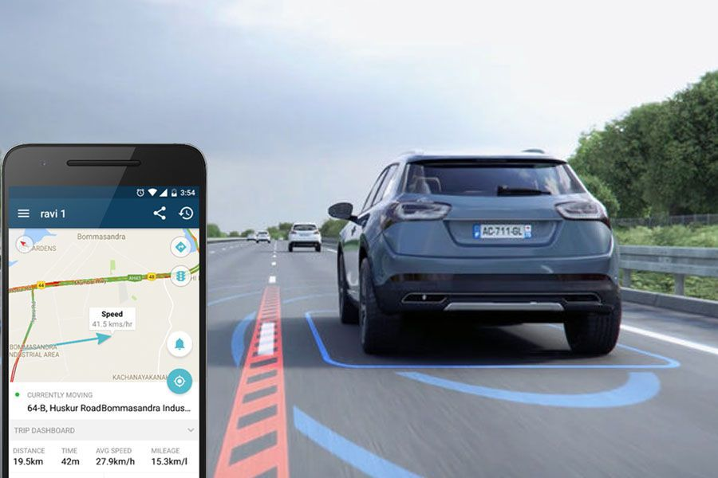
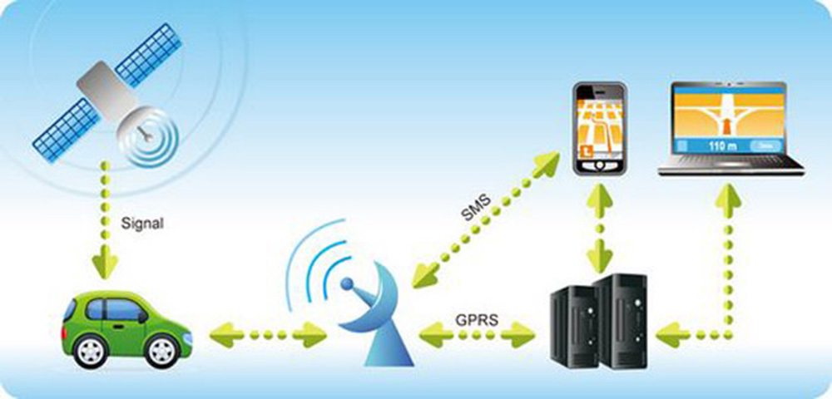
WORKING PROCESS FOR VECHICLE THEFT:

Slide 13
Project Working Process:
Theft System : (through NodeMCU)
OTP match?
Push a button
OTP is sent to authorised mobile number
No
CAR ISN’T UNLOCKED
yes
CAR IS UNLOCKED

Slide 14
Cont..
Accident Detection system (NodeMCU)
If accident occurs , buzzer goes to high state.
An alert message – ‘Accident is detected’ is sent to relatives ( to the number which is priorly set)
Depending on the accident type , if the driver is safe he needs to push a button residing inside the car indicating the vehicle status.
If button is pushed , an alert ‘Vehicle is safe’ is notified
If button is not pushed , an alert ‘Vehicle is not safe’ is notified
GPS locations are also sent as a google map link to the related mobile number as set by driver at the start.

Slide 15
Conclusion:
Henceforth the fright system for vehicle theft and accident detection has been instigated using Arduino UNO and NodeMCU .
The switch1 button helps authorised user to unlock the car and prevents it from unlocking from an unauthorised person.
Incase any accident is detected , the vehicle status (whether safe or not) along with GPS position is updated to any related person or nearest police station , ambulance services. The Google maps boundaries sorts the inspecting of the position at ease.
The key benefits of this scheme exist first of all, decreases vehicle theft problems by the notion of INTERNET OF THINGS.
Furthermore, it helps to save lives of accident victims as early as possible by sending accident location to required numbers.

